Slide 1
Agenda
What is OS ?
Tasks of OS
Types of OS and which OS is recommended for DevOps
Linux Boot Process
AWS Account Setup
Create Virtual Machine with Linux OS

Slide 2
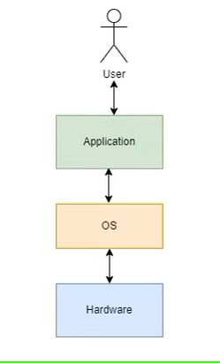
What is an OS ? An Operating System (OS) is an interface between a computer user and computer hardware. When you turn On your computer OS is the first program that runs. Basically, The operating system is something that brings both these components together and put them into work.

Slide 3
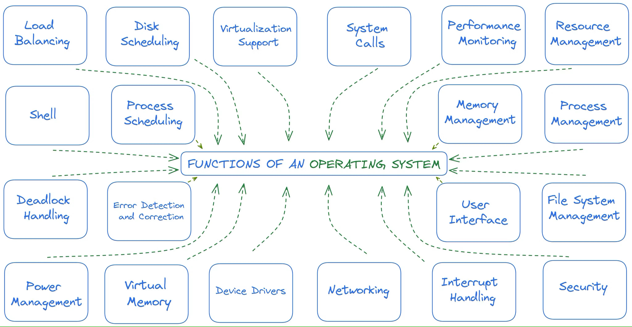
Tasks of an OS

Slide 4
Resource/File management: The resource allocation & deallocation for different users according to their needs. This is also called parallel processing where multiple users access the same resource.
Process management: Management of different processes running by the user such as Microsoft Word, Google Chrome is also done by OS. This is done by CPU Scheduling internally. We can see which process uses what CPU % in task manager.
Memory Management: Memory management refers to the management of Primary Memory or Main Memory i.e RAM. OS keeps track of primary memory; the OS also decides which process will get memory when and how much which is called multiprogramming. OS allocates memory when required by a process and de-allocates the memory when a process no longer needs it or has been terminated.
Storage Management: Management of how data is stored in Secondary storage such as Hard Disk by the file systems.
Device Management: Managing connection of the I/O devices and which device processes get how much time. The program responsible for these tasks is known as the I/O controller.

Slide 5
Popular Operating Systems
There are many popular (used daily by many people) Operating Systems out there. The ones listed below all get the same jobs done (browsing the web, editing documents, playing games, etc), but they approach the problem in a technically or philosophically different way.
UNIX
Linux
Android
Debian
RHEL
MacOS / Darwin
FreeBSD
Windows

Slide 6
Flavors of Linux
Variants (forks) of Linux Operating Systems are called flavors. These are grouped into families based on their operating system ancestry.
Debian
Ubuntu
LinuxMint
RedHat
RHEL
Fedora
Centos

Slide 7
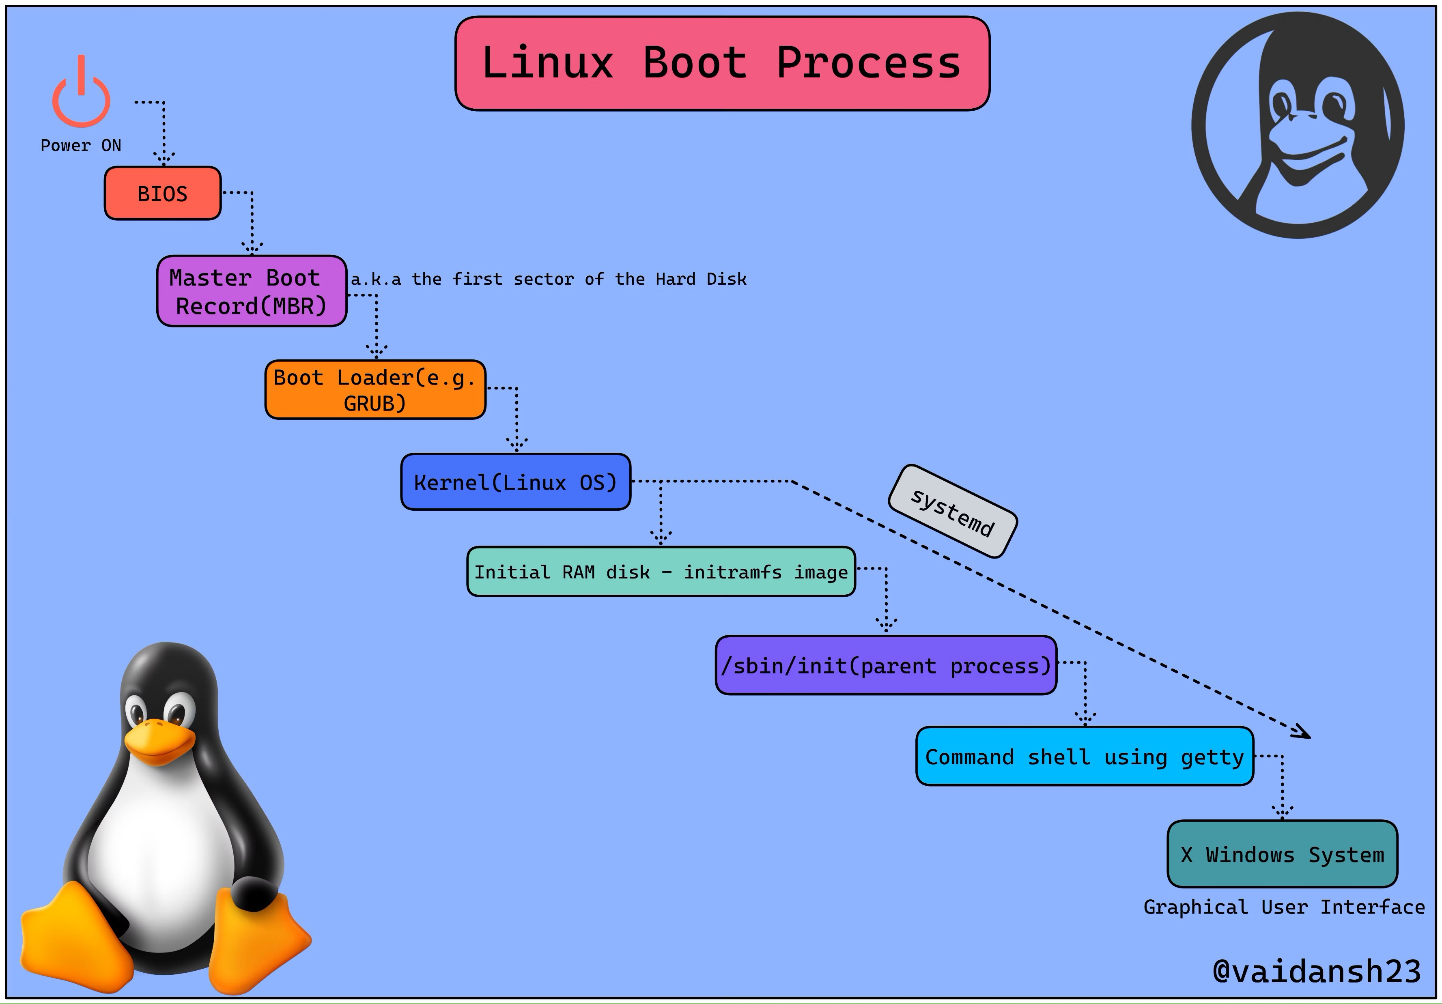
Boot Process

Slide 8
Demo……
AWS Account Setup
Create EC2 instance using Linux OS

Slide 9
THANK YOU

